Slide 1

CodeU Class 9 Welcome!
The class will start shortly
Reproduction and distribution of the presentation deck is prohibited

Slide 2
Agenda for today’s class
Recap of last class
01
02
Project Revision
To refresh our minds!
We’ll revise the previous dodgeball project!
Topic of the day:
03
04
Practice time!
We will see the different Turtle Concepts
Introduction to Turtle
Turtle Exercises
Wrap-up
Conclusion
05
06
CodeU Robot
Summary of what we’ve learned today
Homework and questions

Slide 3

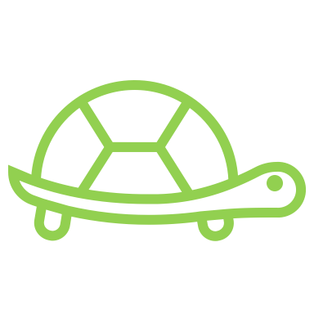

You can use Python as a drawing pad
Import turtle module
1
import turtle
Turtle Module
2
Create turtle
Python module that allows you to draw shapes using commands
Use any name you like
Ex: pen = turtle.Turtle()
3
Move turtle
Imagine a turtle moving across a piece of paper holding a pen, so that it leaves a trail of ink behind
pen.forward(50)
This moves pen by 50 pixels
.forward(x) is a type of method you can use on a turtle.
You can also use .backward(x), .left(a) and right(a)

Slide 4

List of more turtle methods
01
.penup()
.circle(x)
05
Pull the pen up so no drawing is made when the turtle is moving
Draws a circle with the radius x
02
.pendown()
.color(“blue”)
06
Pull the pen down to start drawing when the turtle is moving
Changes the color of the line. See next slides for colors
03
.goto(x, y) or .setpos(x,y)
.shape(“arrow”)
07
Moves the turtle to the position x,y
Changes the tip of the turtle to another shape. See next slides for more shapes.
04
.speed(”slow”)
.pensize(x)
08
Changes the speed of the turtle. Can use “slow”, ”fast”, “fastest”
Changes the thickness of the line to width x.

Slide 5
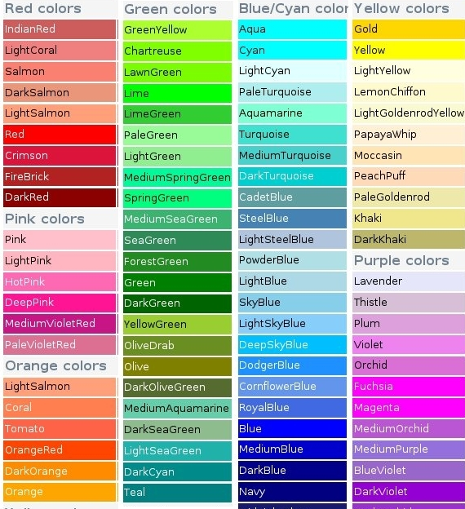
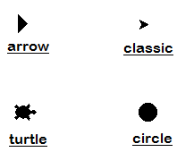
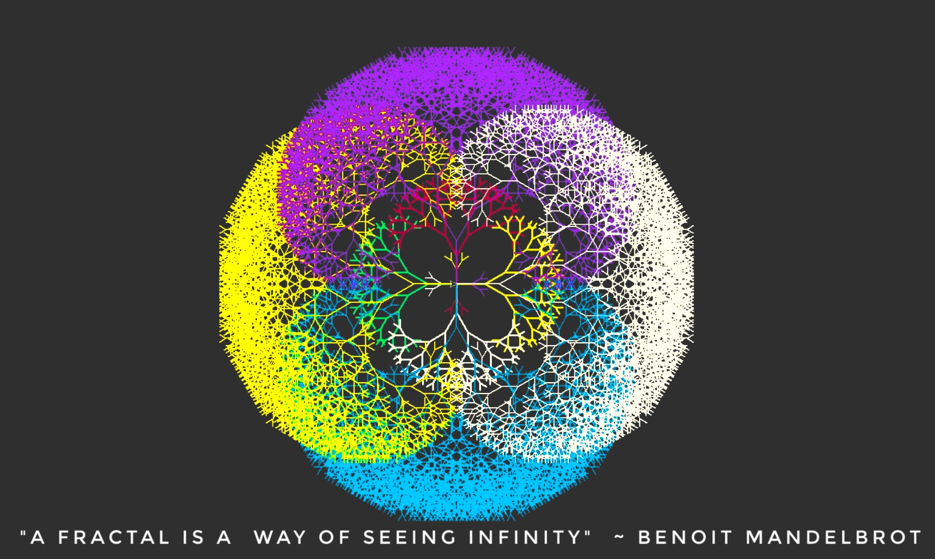
Shapes
Colors
Colors and Shapes
“arrow”
“turtle”
“circle”
“square”
“triangle”
“classic”

Slide 6
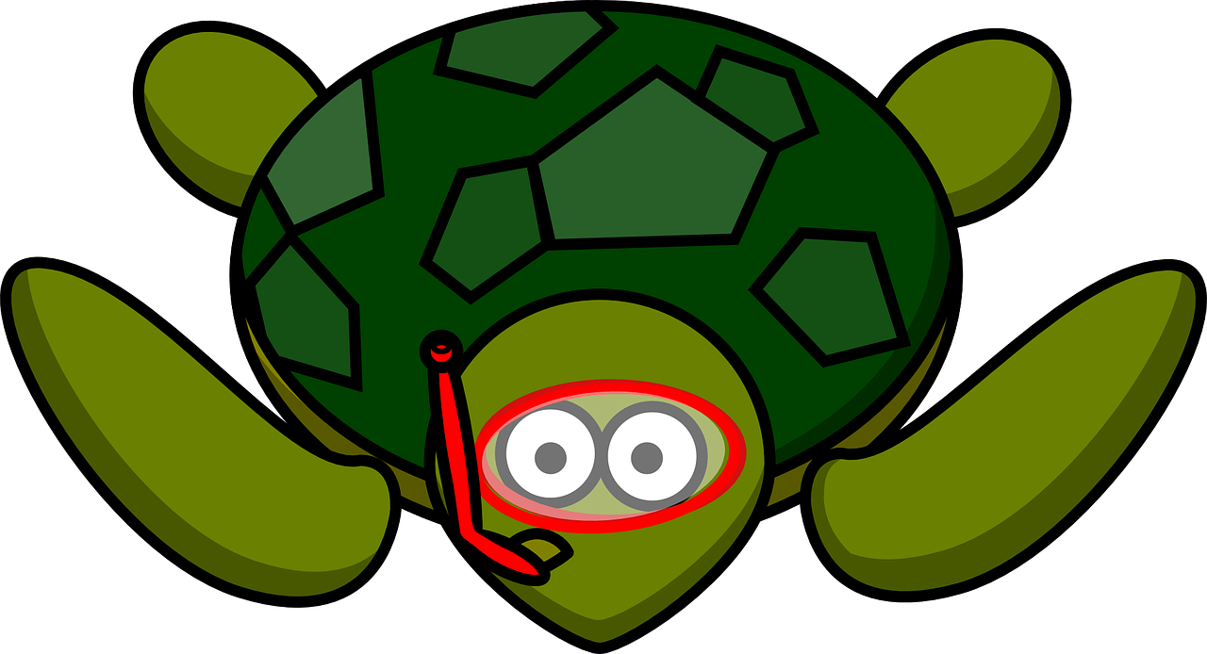
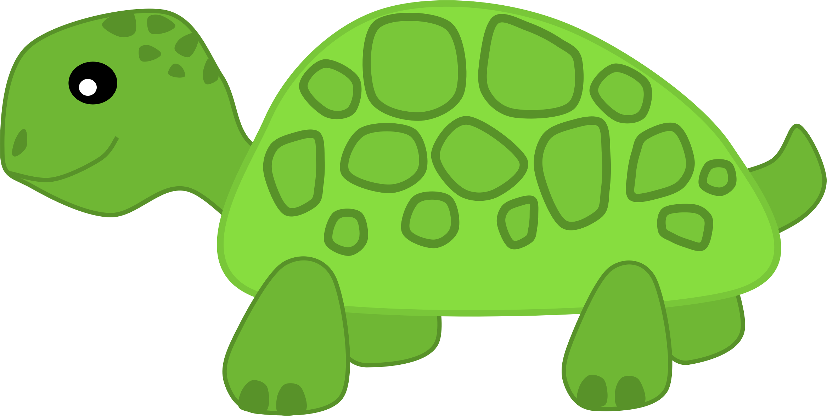
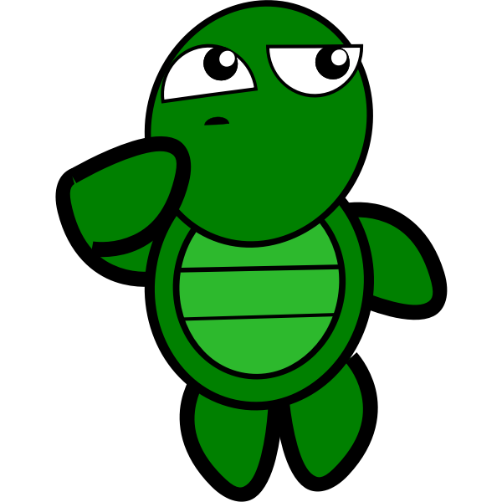
Turtle Exercises!
01
03
Draw a Square!
Fill a shape!
pen.forward(100)
pen.left(90)
pen.forward(100)
pen.left(90)
pen.forward(100)
pen.left(90)
pen.forward(100)
.begin_fill() and .end_fill()
Fills your shape with color!
pen.color(“yellow”, “red”)
pen.begin_fill()
pen.forward(100)
pen.left(90)
pen.forward(100)
pen.left(90)
pen.forward(100)
pen.left(90)
pen.forward(100)
Pen.end_fill()
Rules:
begin_fill() must be at the beginning of your drawing and end_fill() must be at the end
The second color when determining your pen color will be the fill color
02
Draw a Circle!
pen2.circle(40)

Slide 7
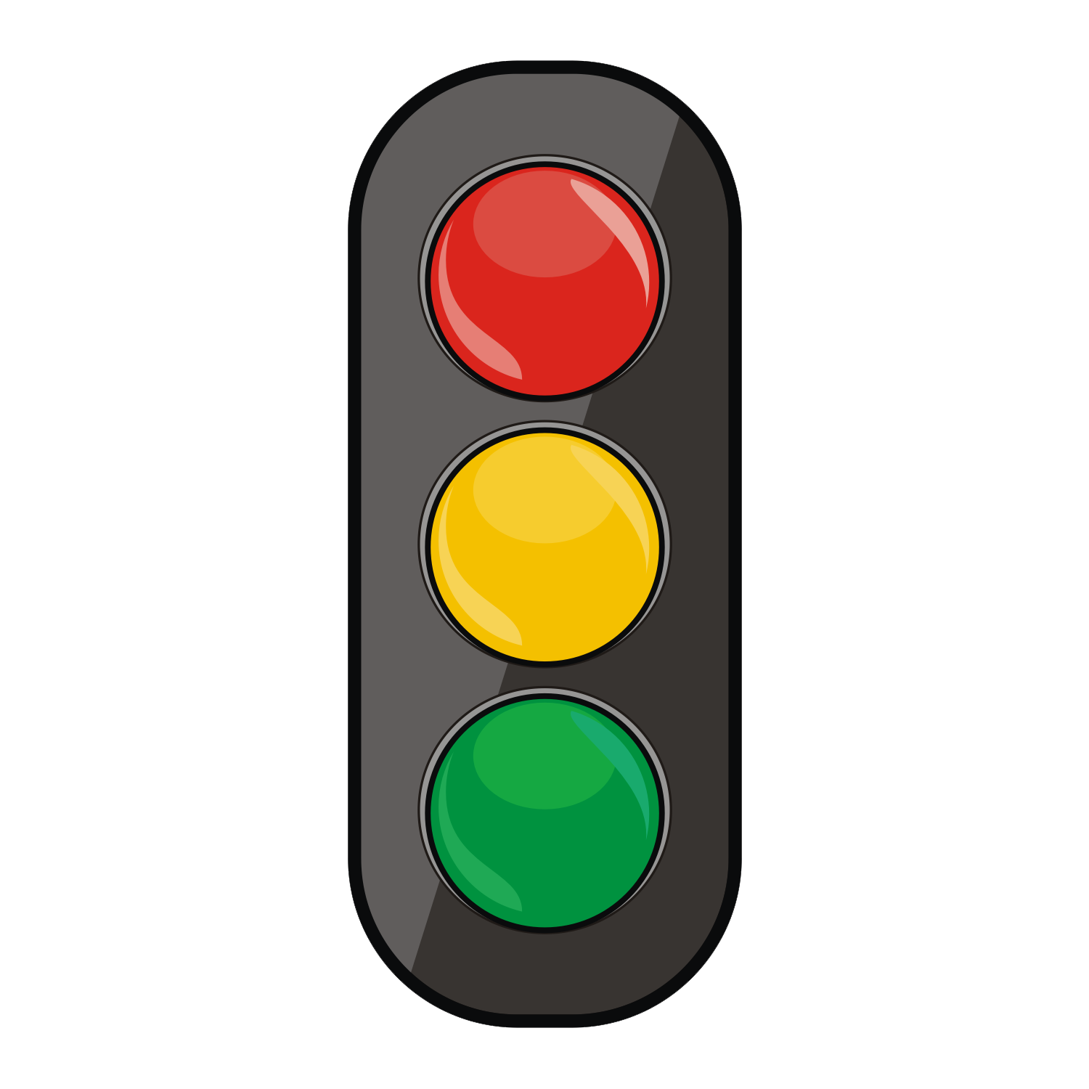
Final Exercise: Traffic Lights!
02
Step 1
Create one pen for EACH color and set the color for those pens. (P.S Don’t forget the fill color!)
Step 2
Create the 1st light: This will be the red light. You don’t need to set a position for the first light. This light has to be filled.
Step 3
Create the 2nd light: This will be the yellow light. The position for this light will be under the first light. This light has to be filled.
Step 4
Create the 3rd light: This will be the green light. The position for this light will be under both lights. This light has to be filled.

Slide 8
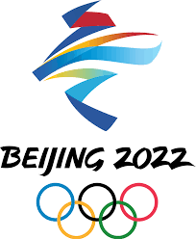
Homework: Olympic Rings!
The commissioner of the Olympics has asked you to create the Olympic rings using Python!
Reminders:
.penup()
.pendown()
.goto(x, y)
.circle(radius)
.color(“color”)
.forward(x)
.right(x)
Steps to creating our drawing
Import turtle
Create a turtle pen for the first row of rings
Create a second pen for the second row
Set the position for the 1st ring at (-80, 80)
Draw the 1st circle(“blue”) with a radius of 50
Move to 2nd circle → forward(80)
Draw 2nd circle(“black”) with radius of 50
Move to 3rd circle → forward(80)
Draw 3rd circle(“red”) with radius of 50
Set the position for the 4th ring at (-40,0)
Draw 4th ring(“green”) with radius of 50
Move to 5th circle → forward(80)
Draw 5th circle(“yellow”) with radius of 50

Slide 9
Homework Solution: Olympic Rings!
Create 2 separate pens for the 2 rows or rings
p1 = turtle.Turtle()
p2 = turtle.Turtle()
First Row Of Rings
First Ring: Blue
Set the position for the 1st ring
p1.penup()
p1.setpos(-80, 80)
p1.pendown()
p1.color("blue")
p1.circle(50)
Second Ring: Black
Set the position for the 2nd ring
p1.penup()
p1.forward(80)
p1.pendown()
Draw the ring
p1.color("black")
p1.circle(50)
Third Ring: Red
Set the position for the 3rd ring
p1.penup()
p1.forward(80)
p1.pendown()
Draw the ring
p1.color("red")
p1.circle(50)
Second Row Of Rings
Fourth Ring: Green
Set the position for the 4th ring
p2.penup()
p2.setpos(-40, 0)
p2.pendown()
Draw the ring
p2.color("green")
p2.circle(50)
Fifth Ring
Set the position for the 5th ring
p2.penup()
p2.forward(80)
p2.pendown()
We can now draw our final circle!!!
p2.color("yellow")
p2.circle(50)

Slide 10



Thank you!
Does anyone have any questions?
Next class: class 10!
Phone:
(438) 391-9106
Please contact us to make any change in the schedule for the next class.
Email:
siva.sri14@hotmail.com
hello@codeu.ca
Website:
https://www.codeu.ca/
Reproduction and distribution of the presentation deck is prohibited

